Slide 1
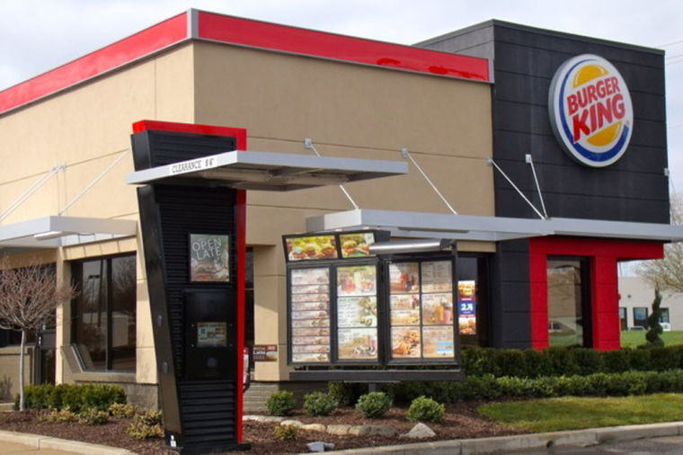
BURGER KING RESTAURANT

Slide 2
INTRODUCTION
Waiting for too long
Burger not same size and quality as advertised

Slide 3
OBJECTIVE
Waiting for too long
https://www.youtube.com/watch?v=AFpmXqPyrdY
Burger not same size and quality as advertised
https://www.youtube.com/watch?v=XrZFM2nvLXA

Slide 4
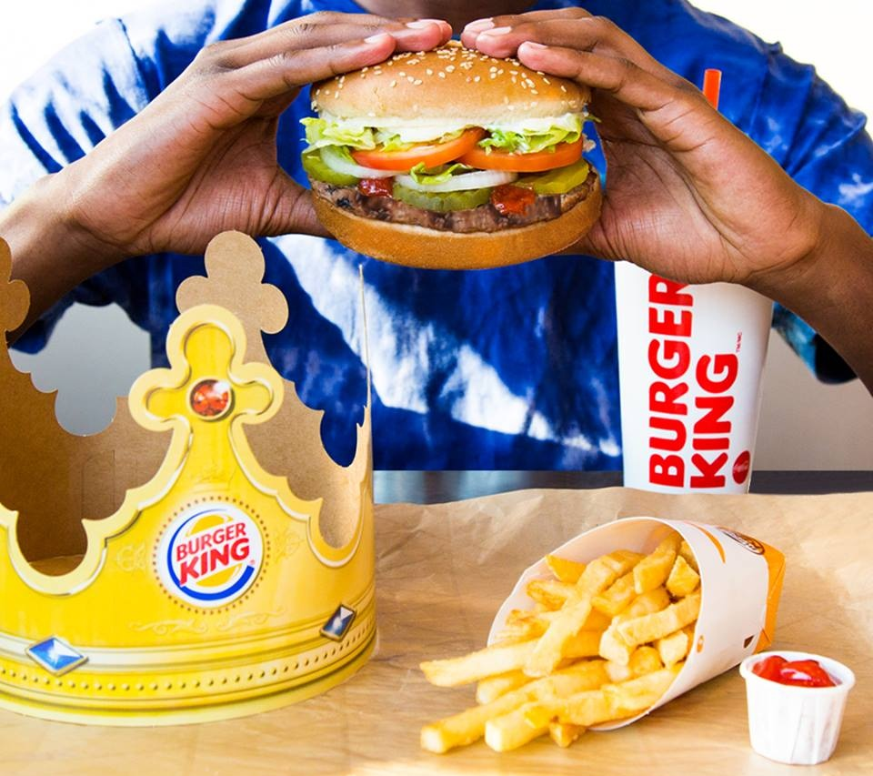
SOLUTION
Faster service delivery
Good quality burgers

Slide 5
DMAIC
Define: waiting for too long and burger not same size as advertised
Measure: less working personnel
Analyze: many customers flocking in for the burgers
Improve: Increase the number of working personnel and quality of burgers
Control: listening to customer complaints and improving in service delivery

Slide 6
CONCLUSION
Increase the number of personnel
Increase the sizes and quality of burgers

